Slide 1



SNS COLLEGE OF ENGINEERING Kurumbapalayam (Po), Coimbatore – 641 107 AN AUTONOMOUS INSTITUTION Accredited by NAAC – UGC with ‘A’ Grade Approved by AICTE, New Delhi & Affiliated to Anna University, Chennai
DEPARTMENT OF COMPUTER SCIENCE AND ENGINEERING
19DT102-DESIGN THINKING & INNOVATION
Il-YEAR
TRAIN ACCIDENT PREDICTION AND
PREVENTION
TEAM MEMBERS:
Dilipkumar. S
Elavarasan. C
Dharwin. V
Lokesh.

Slide 2
INNOVATION TECHNOLOGIES
7 - INNOVATION TECHNOLOGIES:
ROBOTICS & AUTOMATION
AR/VR/META-VERSE/GAMING & DIGITAL TWINS
DATA SCIENCE /AI/ ML
INTERNET OF THINGS
COMMUNICATION AND GROWTH TECH
ADDITIVE MANUFACTURING (3D Printing)
LOW CODE DEVELOPMENT

Slide 3
INDUSTRY VERTICALS
7-INNOVATION INDUSTRY VERTICALS :
SMART CITY/MANUFACTURING
HEALTH CARE
AGRICULTURE & FOOD TECHNOLOGY
AUTOMOBILES
AEROSPACE AND DEFENCE
RETAIL, REAL ESTATE, ENTERTAINMENT & FINANCE
POWER/ENERGY

Slide 4


Abstract
Railway accident prevention and protection are a key part of a wider picture of transport safety. The rail sector thus needs to improve its knowledge of trespassing and suicide, including at level crossing, in order to work out suitable responses by analyzing measures already taken in various countries. Governments, the rail industry and road organizations have been implementing a variety of countermeasures for many years to improve railway safety. These actions are substantial and have resulted in a continuing decrease in the number and the severity of accidents. This paper presents existing suitable techniques that are used in the preventative measures targeted to reduce railway suicides, trespassing and level crossing user accidents.

Slide 5
EMPATHY
1.All the models and ideas that have been made under the topic prevention of railway accident is still in development and will many difficulties in developing it.
2.But they are not insisting in preventing the accidents with cost productive materials.
Empathy: All the models and ideas that have been made under the topic prevention of railway accident is still in development and will many difficulties in developing it. So most of the models are failing in financial part. Using expensive materials, Simple drones, sensors in tracks etc. But they are not insisting in preventing the accidents with cost productive materials.

Slide 6
DEFINE
1.Enable to Alert The Train Engine Drivers.
2.Enable to Stop the Train at The Moment cause of Time restriction

Slide 7
IDEATE
1.Train Accident Prevention
2.Alarm System
3.Laser Wave System

Slide 8
PROTOTYPE
COMPONENTS:
1.Ultrasonic Sensor
2.Monitor
3.Tranmitter
4.Receiver
5.MicroController-ARDINO
6.Screws&Bolts

Slide 9
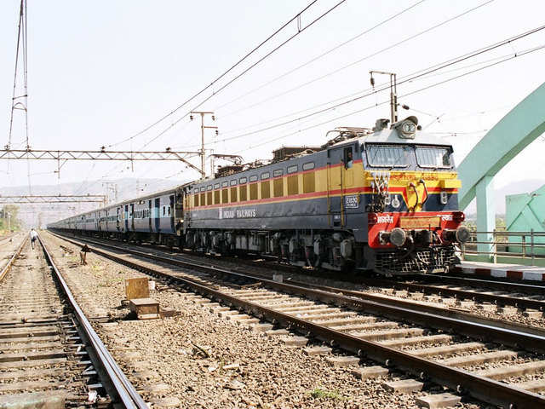
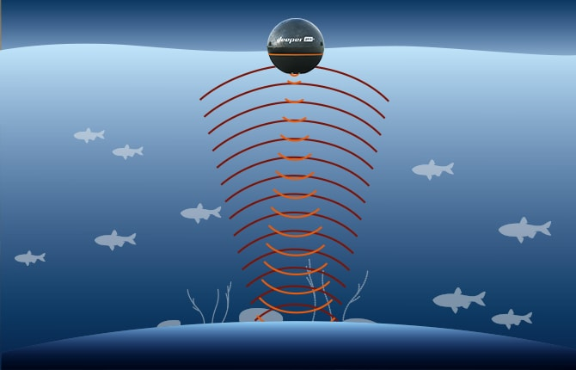
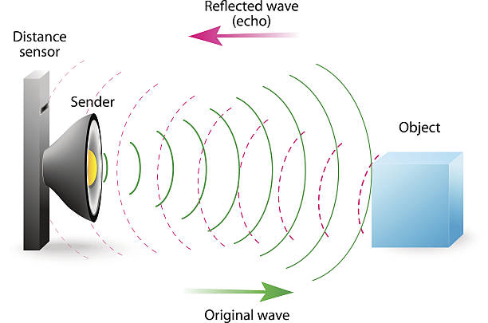
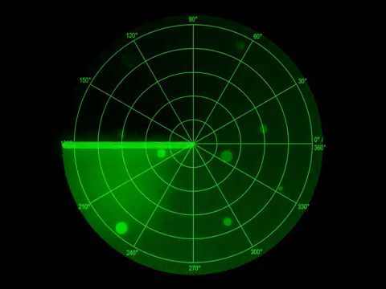
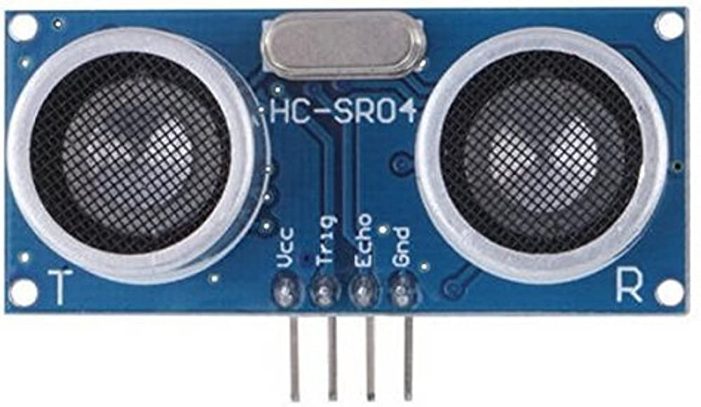

Slide 10
PROTOTYPE
device is manufactured using Atmel’s high;
The density non-volatile memory technology. The On-chipISP Flash allows the program memory to bereprogrammed In-System through an SPI serialinterface, by a conventional non-volatile memoryprogrammer, or by an On-chip Boot program running onthe AVR core. The Boot program can use any interfaceto download the application program in the ApplicationFlash memory. Software in the Boot Flash section willcontinue to run while the Application Flash section isupdated, providing true Read-While-Write operation.

Slide 11
PROTOTYPE
device is manufactured using Atmel’s Ahigh ;
Bycombining an 8-bit RISC CPU with In-System Self-Programmable Flash on a monolithic chip, the AtmelATmega328P is a powerful microcontroller thatprovides a highly flexible and cost effective solution tomany embedded control applications. The ATmega328PAVR is supported with a full suite of program andsystem development tools including: C Compilers,Macro Assemblers, Program Debugger

Slide 12


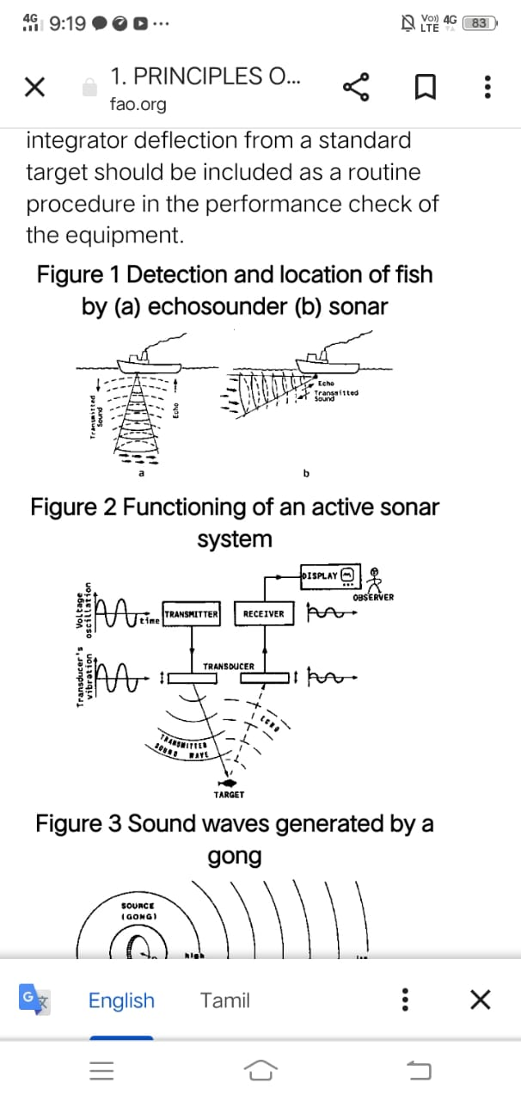
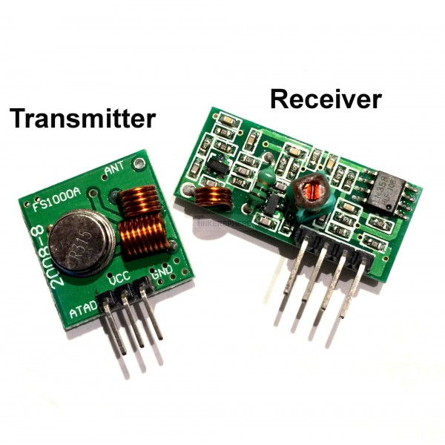
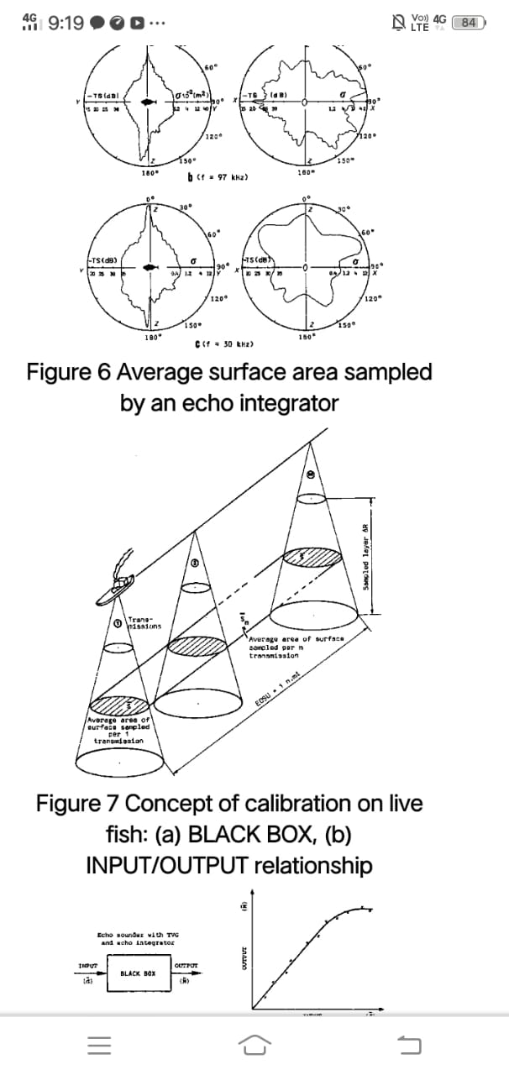
PROTOTYPE

Slide 13
PROTOTYPE
Ultrasonic Sensor 1;
Ultrasonic sensors (also known as transceiverswhen they both send and receive, but more generallycalled transducers) work on a principle similar to radaror sonar, which evaluate attributes of a target byinterpreting the echoes from radio or sound wavesrespectively. Active ultrasonic sensors generate highfrequency sound waves and evaluate the echo which isreceived back by the sensor, measuring the time intervalbetween sending the signal and receiving the echo todetermine the distance to an object. Passive ultrasonicsensors are basically microphones that detect ultrasonicnoise that is present under certain conditions.

Slide 14
C. Buzzer
A buzzer or beeper (BUZZERS) is a signallingdevice, usually electronic, typically used in automobiles,household appliances such as a microwave oven orgame shows.
D. Power Supply
The input to the circuit is applied from theregulated power source. The microcontroller power is of5V. The A.C. input i.e., 230V after the mains supply isstep down by the transformer to 12V and is fed to arectifier. The production gained from the rectifier is apulsating D.C voltage.

Slide 15
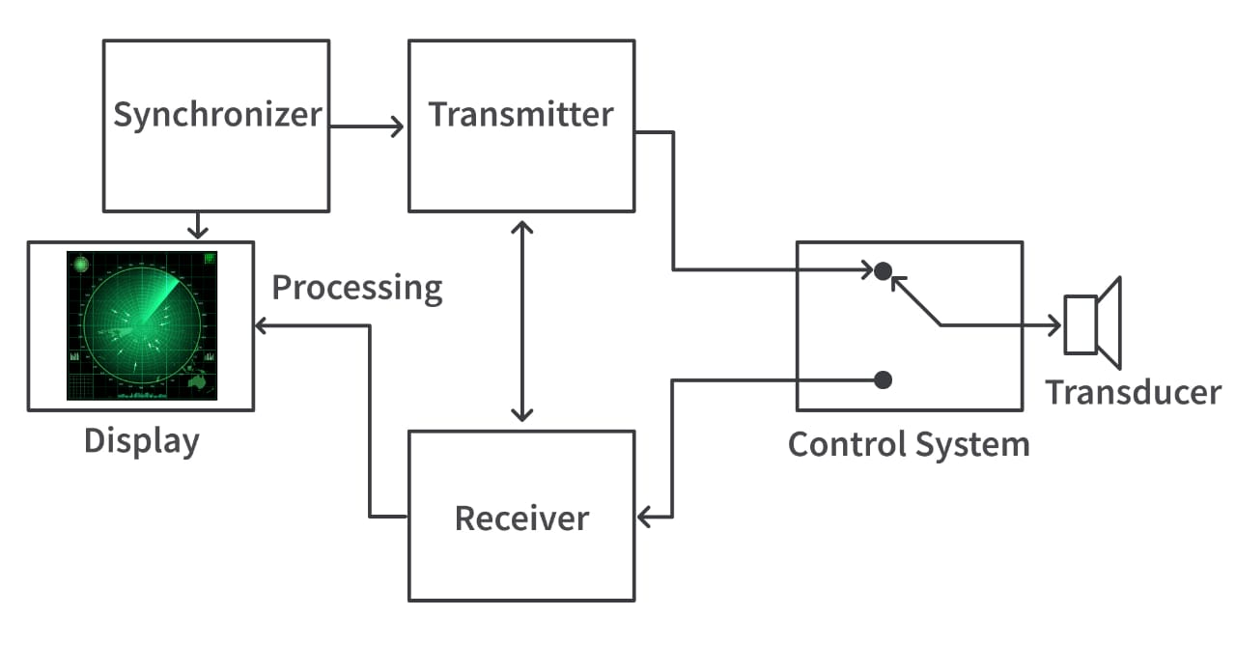
PROTOTYPE

Slide 16
REFERENCE
[1] RanuDewangan, Pratibhadevi Umesh “Automatic Accident Control
Sysem on Railway Tracks” International Journal of Advanced
Research in Electronics and Communication Engineering(IJARECE)
Volume 5, Issue 7, July 2016.
[2] Ms.K.Divya&Ms.R.Anjugam “Railway Safety Monitoring System
using Ultrasonic and IR Sensor” IJSRD- International Journal for
Scientific Research & Development vol. 5, Issue 01, 2017/
ISSN(Online):2321-0613.

Slide 17
THANK YOU
A buzzer or beeper (BUZZERS) is a signallingdevice, usually electronic, typically used in automobiles,household appliances such as a microwave oven orgame shows.
D. Power Supply
The input to the circuit is applied from theregulated power source. The microcontroller power is of5V. The A.C. input i.e., 230V after the mains supply isstep down by the transformer to 12V and is fed to arectifier. The production gained from the rectifier is apulsating D.C voltage.

